Slide 1

Software Engineering (2301CS405)
Lab 2 UML Diagram
Prof. R. B. Gondaliya
Computer Engineering Department
rajkumar.gondaliya@darshan.ac.in
+91-9723232741

Slide 2
Use Case Diagram
A use case diagram is a visual representation that shows the interactions between users (actors) and a system to achieve specific goals.
It provides an overview of how different users interact with the system and the functions that the system must support to meet their needs.
Use case diagrams are widely used in the requirements gathering phase of software development to clarify what the system should do from the user's perspective.

Slide 3

Components of Use Case diagram
System boundary
Use case
Represent the scope of the system
This is the box around the use cases that marks the boundary of the system.
Actors who interact with the system are placed outside the system
These represent the actions or tasks the system should do.
Use cases are shown as ovals in the diagram.
Use
Cases
Actor
Association
An actor is an entity that interacts directly with the system but that is not part of system
Actor may be people, computer hardware, other systems, etc.
Shows the connection between actors and use cases, indicating that the actor is involved in the action.

Slide 4
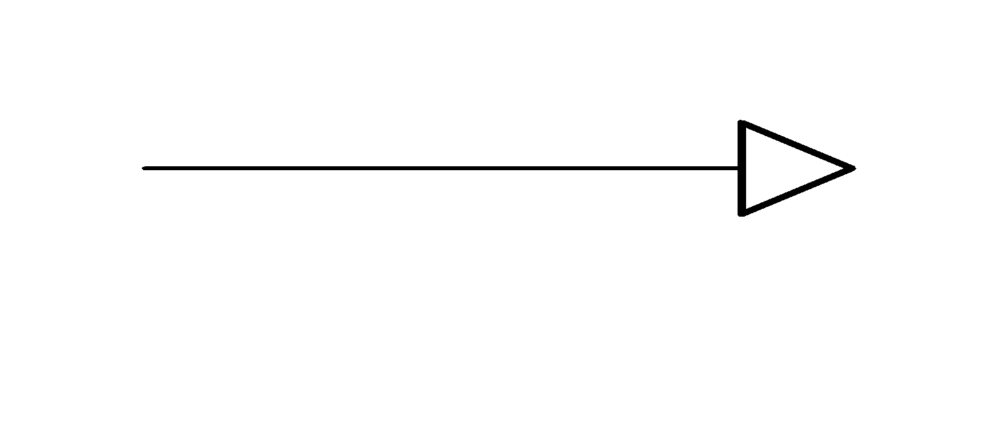
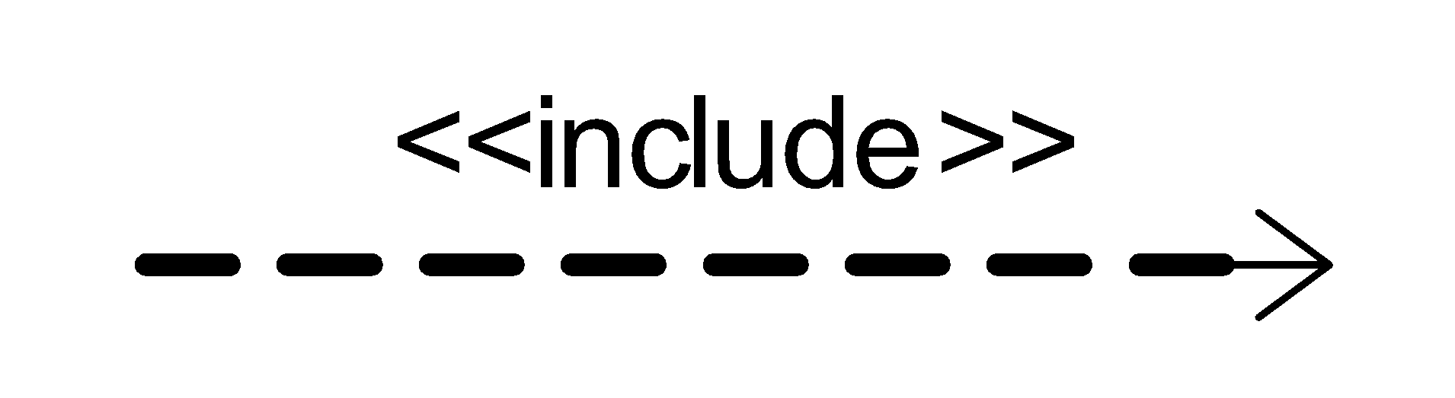
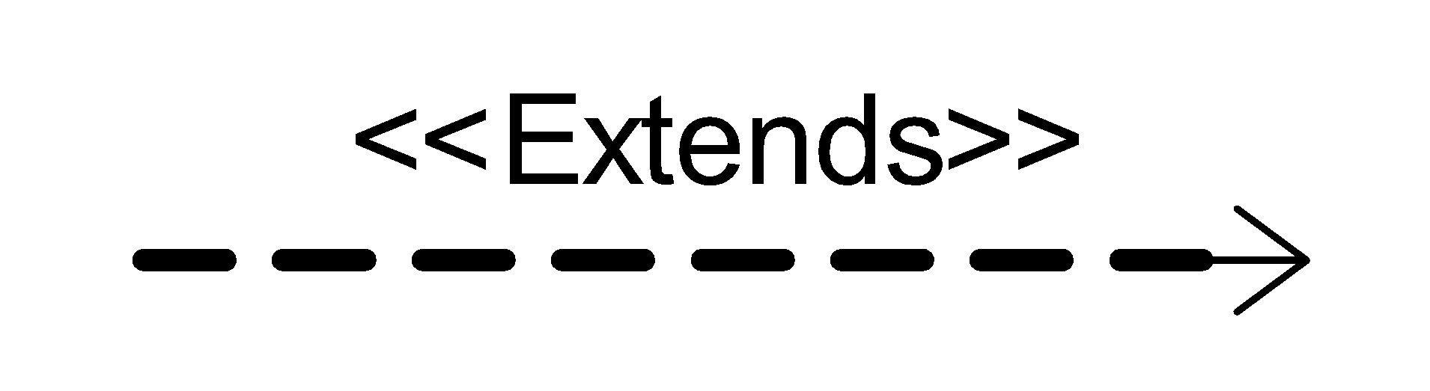
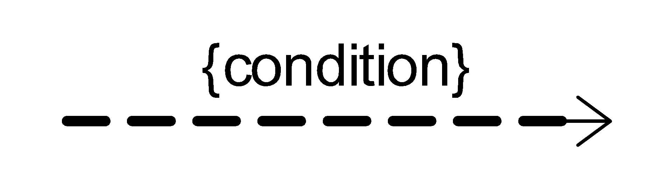
Components of Use Case diagram Cont.
Generalization
Include
A generalization relationship is used to represent the inheritance relationship between model elements of the same type
The use case is mandatory and part of the base use case.
For Example:
Use case: "Borrow Book“
Includes: "Check Book Availability" (This
must always happen before borrowing
a book.)
Extend
Constraint
The use case is optional and comes after the base use case.
For Example:
Use case: “Place Order”
Extending Use Case 1: "Apply Discount Code“
Extending Use Case 2: "Gift Wrap Item"
Show condition exists between actors and activity
For Example:
Use case: "Return Book“
Extends: "Apply Late Fee" (This only happens
if the book is returned late.)

Slide 5
Example of Extends and Include
Includes
Login
In e-commerce application that provides customers with the option of checking the status of their orders. For checking the status of their order user should be login.
This behavior is modeled with a base use case called CheckOrderStatus that has an inclusion use case called LogIn.
<<include>>
CheckOrder Status
Extends
pay for item
In e-commerce site, When paying for an item, you may choose to pay on delivery, pay using PayPal, or pay by card.
These are all alternatives to the "pay for item" use case. I may choose any of these options depending on my preference.
<<extend>>
<<extend>>
pay by card
pay on delivery

Slide 6
Guideline for constructing use case diagram
Determine the system boundary.
Everything inside the box is part of the system's functions, while actors and external elements are outside the box.
Each use case must provide value of users
Relate use cases and actors
Don’t overcrowd the diagram. Focus on the main actors and the most important use cases.

Slide 7
W5 Of Use Case Diagram
Who uses a use case diagram?
Used by designers, developers, analysts, and stakeholders.
What is a use case diagram?
A diagram that shows system interactions, with actors (users), use cases (functions),
and relationships to define system scope.
Why do we use a use case diagram?
To clarify system requirements by showing all user interactions with the system.
Where do we use a use case diagram?
Primarily in requirements gathering, design meetings, and documentation.
When do we use a use case diagram?
During the requirements and planning phases, or when requirements change.

Slide 8
Identify the Functionality & Stakeholders for LMS
Functionality
Stakeholders
Register User
Add Article
Update Article
Delete Article
Inquiry Members
Inquiry Issuance
Check out Article
Check in Article
Reserve Article
Set user Permission
Search Article
Check Account
Prepare Library Database
Librarian
Member
Guest

Slide 9
Relationship Between Functionality & Stakeholders
Register user
Add Article
Update Article
Delete Article
Inquiry Members
Inquiry Issuance
Check out Article
Check in Article
Set user Permission
Request for registration
Guest
Librarian
Reserve Article
Search Article
Check Account
Member

Slide 10
Use Case Diagram Library Management
Library Management System
Login
Request registration
Register user
Manage member permission
Guest
Add Article
Check account
Delete Article
Search by title
Inquiry article
<<extend>>
Member
Inquiry member
Search article
Librarian
Check in articles
<<extend>>
Check out articles
Search by publication

Slide 11
Activity Diagram
An activity diagram visually presents a series of operation or flow of control in a system similar to algorithm or a flowchart.
An activity diagram is like a flowchart that shows the step by step in a process, one after the other.
An activity diagram can show both sequential and concurrent flow of control.
Activity diagram mainly focus on the sequence of operation rather than on objects.
Activity diagram represent the dynamic behavior of the system or part of the system.
An activity diagram shows ‘How’ system works.
Activity diagrams are most helpful when planning workflows or designing algorithms in the early stages.

Slide 12
Elements of Activity Diagram
Initiation
The starting point of an activity diagram is shown as a solid circle with an outgoing arrow.
When an activity diagram is activated, control starts at the solid circle and proceeds via the outgoing arrow toward the first activities.
Termination
The end of an activity diagram is shown as a bull’s eye, which is a solid circle inside a hollow circle.
The symbol only has incoming arrows.
When control reaches a bull’s eye, the overall activity is complete and execution of the activity diagram ends.

Slide 13
Elements of Activity Diagram
Activity
Activity
The main element of an activity diagram is the activity itself.
An activity is specific tasks or actions performed in the workflow.
An arrow between two activities shows that the first activity must finish before the second one can start.
[true]
[false]
Branches
If an activity has more than one possible next step, each arrow leading to the next step can have a condition written in square bracket.
A diamond shape is used to represent these choices.
The diamond has one arrow coming in and two or more arrows going out.

Slide 14
Elements of Activity Diagram Cont.
Concurrent Activities
System can perform more than one activity at a time.
For e.g. one activity may be followed by another activity, then split into several concurrent activities (a fork of control), and finally be combined into a single activity (a merge of control).
A fork or merge is shown by a synchronization bar –a heavy line with one or more input arrows and one or more output arrows.
Merge
Fork

Slide 15
Example of Fork & Join
An example of business flow activity of order processing, based on the Example order is input parameter of the activity.
After order is accepted and all required information is filled in, payment is accepted and order is shipped.
Note, that this business flow allows order shipment before invoice is sent or payment is confirmed.
Process Order
Receive Order
Fill Order
Send Invoice
[priority order]
[else]
Special Delivery
Regular delivery
Receive Payment
Close Order

Slide 16
W5 Of Activity Diagram
Who uses an activity diagram?
System designers, developers use activity diagrams to understand workflows and processes.
What is an activity diagram?
It is a diagram used to visually represent the flow of activities or processes within a
system, including actions, decisions, and the sequence of tasks.
Why is an activity diagram important?
To provide a clear understanding of how processes flow step-by-step.
Where are activity diagrams used?
In any domain requiring process analysis, such as software development and system design.
When do we use an activity diagram?
During the design and analysis phase of software development to map out workflow.

Slide 17
How to Draw an Activity Diagram
Step 1: Identify the various activities and actions your business process or system
Step 2: Find a flow among the activities
For e.g. in library management system, book issue is a one business process or a function. Show we prepare a activity diagram for Book issue.
Various activity in book issue process like…
Check availability of book
Validate the member
Check No. of books issued by member
Add book issue details to transaction
Update no of book issued by member
Update book status.

Slide 18
Activity Diagram for Book Issue
Check availability book
[book not available]
Alert “Book not available”
[book available]
Validate Member
Alert “not a valid member”
[unauthorized user]
[authorized user]
No. of books issued to member
[max limit]
Alert “No more book can be issued”
[else]
Add book issue details to transaction
Update no of book issued to member
Update book status

Slide 19
Swimlane Diagram
A Swimlane Diagram is a type of activity diagram that shows which person or department is responsible for each activity in a process.
Each column is called swim-lane by analogy to a swimming pool.
Placing an activity within a particular swim-lane indicates that is performed by a person/ department.
Lines across swim-lane boundaries indicate interaction among different person/department.
Lines crossing between lanes show how different people or departments interact with each other during the process.

Slide 20
W5 Of Swimlane Diagram
Who uses a swimlane diagram?
Business analysts, project managers, process designers, and stakeholders.
What is a swimlane diagram?
A type of activity diagram that divides tasks into lanes to show who (person/department)
is responsible for each activity in a process.
Why is a swimlane diagram important?
To visualize interactions between people or departments.
Where is a swimlane diagram used?
In business process modeling, project planning, and system design.
When do we use a swimlane diagram?
When assigning or clarifying responsibilities in a process.

Slide 21
How to Draw a Swimlane Diagram
Step 1: Identify the various activities and actions your business process or system
Step 2: Figure out which person/departments are responsible for the competition of activity.
Step 3: Figure out in which order the actions are processed.
Step 4: Figured out who is responsible for each action and assign them a swimlane and group each action they are responsible for under them

Slide 22
Swimlane Diagram for Book Issue
Librarian
Library Management Software
Check availability book
[book not available]
Alert “Book not available”
[book available]
Validate Member
[unauthorized user]
Alert “not a valid member”
[authorized user]
No. of books issued to member
[max limit]
Alert “No more book can be issued”
[else]
Add book issue details to transaction
Update no of book issued to member
Update book status

Slide 23
Sequence Diagram
A Sequence Diagram is a UML (Unified Modelling Language) diagram that shows how objects or actors interact through a series of messages over time. It visually represents the flow of use case in a sequential manner.
Sequence diagram represent the dynamic communication between object during execution of task.
Each use case requires one or more sequence diagram to describe its behavior.
Each sequence diagram shows a particular behavior sequence of the use case.
You can draw a separate sequence diagram for each task.

Slide 24
Components of Sequence Diagram
Object - Class Roles or Participants
Object : Class
Represents individual entities or objects included in the interaction.
Activation or Execution Bar
Activation boxes or bars represent the time during which an object is performing an action.
Lifeline
A lifeline represents a Object in an interaction.
When that object's lifeline ends, you can place an X at the end of its lifeline to denote a termination.
X

Slide 25
Components of Sequence Diagram Cont.
Messages
Messages are communication between actors and objects or 2 objects.
Asynchronous message
Solid line with an open arrowhead, indicating a call that does not wait for a response.
Only the call should be included in the diagram.
Synchronous message
Solid line with a filled arrowhead, indicating a call that waits for a response.
The diagram should show both the call and the reply.
Reply message
Represented by a dashed line with a lined arrowhead.
these messages are replies to calls.

Slide 26
Components of Sequence Diagram Cont.
Delete message
X
Represented by a solid line with a solid arrowhead, followed by an X.
This message destroys an object.

Slide 27
Steps to Draw a Sequence Diagram
Step-1
Identify the scenario.
Step-2
Determine objects and actors which are taking part.
Step-3
Determine the flow of interactions.
Step-4
Describe the message exchange between object.
Step-5
Add lifelines and activations.

Slide 28
Example: Sequence Diagram for Book Issue
Book issue is a one business process or a function in Library Management System.
Necessary objects for book issue process are Librarian, Book, Member and Transaction .
Member class object starts the interaction.
Various interactions in book issue process are
1
Request for a book
2
Check availability of book
3
Validate the member
4
Check No. of books issued by member
5
Add book issue details to transaction
6
Update no of book issued by member
7
Update book status

Slide 29
Sequence Diagram for Book Issue
L:Librarian
B:Book
MR: Member
1. Request for a book
2. Check availability of book
3. Book available rack no.
4. Validate Member
5. Response for validation
6. Check no of book issued
7. Book can be issued
8. Update book status
9. Update member status

Slide 30
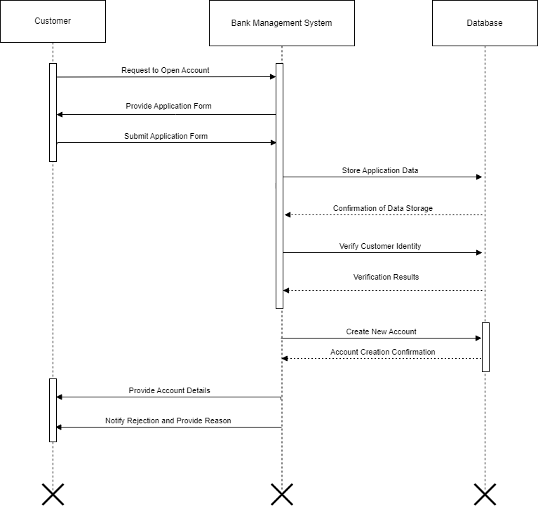
Sequence diagram for Accounting Opening Process

Slide 31
W5 FOR SEQUENCE DIAGRAM
WHAT IS A SEQUENCE DIAGRAM?
A sequence diagram is a UML tool that models the step-by-step flow of messages and interactions between system components over time.
WHY DO WE USE A SEQUENCE DIAGRAM?
We use it to visualize and understand the dynamic flow of interactions between system components in a specific sequence.
WHEN DO WE USE A SEQUENCE DIAGRAM?
We use it to model, analyse and explain the flow between objects or components in a system during a specific process or a scenario.
WHERE DO WE USE A SEQUENCE DIAGRAM?
We use it in software designing, development and analysis to model system interactions, workflows and communication sequences.
WHO USES A SEQUENCE DIAGRAM?
Developers, System architects, business analysts and testers use sequence diagram to understand, design and documents the system interactions.

Slide 32
State diagram
A State Diagram shows states of object or system and transitions triggered by events. It help visualize how an entity changes states in response to different conditions.
Events represent external stimuli or triggers and states represent value of objects.
All objects in a class execute the state diagram for that class, which models their common behavior.
The UML notation for a state diagram is a rectangle with object name in a small pentagonal tag in the upper left corner.

Slide 33
Components of state diagram
State
State
Drawn as a rounded box containing the name of the state.
State names must be unique within the scope of the state diagram.
It represents the condition or situation of an object at a specific point in its lifecycle.
Initial State
A special state showing where the object’s lifecycle begins which is represented by a filled circle.
Final State
OR
Indicates the end of the object’s lifecycle, represented by a circle with a surrounding border or a bull’s eye.

Slide 34
Components of state diagram
Transition/Event
event(attribs) [condition]
Arrows that show the movement between states triggered by events or conditions.
Guard condition
event(attribs) [condition]
Boolean expressions that must be true for a transition to occur, placed in square brackets.

Slide 35
How to draw a state diagram
Step 1: Identify the objects and its lifecycle.
Step 2: List all possible states.
Step 3: Identify events and triggers.
Step 4: Define transitions.
Step 5: Mark initial and final states.
Step 6: Label guard conditions and actions.
Step 7: Verify, refine and finalize the diagram.

Slide 36
State diagram for library management system
Identify the important objects
Book
CD/DVD
News Paper
Librarian
Member
Identify the states of Book’s Object
Available
Issue
Return
Renew
Identify the events / transition
Book issued to user
Submit the book
Request to issue same book
Completion of exam / end of the Semester

Slide 37
State diagram of book
Book
Available
Book issued to user
Issue
Submit the book
[After completion of exam] OR Book No of Days Completed OR User want to Return the book
Request to issue same book
Book re-issue
Return
Renew

Slide 38
State diagram of Bank Automated Teller Machine (ATM)
Bank ATM
turn off / shut-down
off
turn off / shut-down
turn on /
startup
successfully
Self Test
failure
turn on /
restart
service
Maintenance
failure
Out of Service
Idle
card inserted
cancel
service
remove card
failure
serving customer
Customer Authentication
Selecting Transaction
Transaction

Slide 39
State diagram of Online Order
Order
order received
Unprocessed
[reject] Checked
[accept] Checked
Rejected
Accepted
items are not available
items are available
Pending
items are available
Fulfilled

Slide 40
W5 FOR STATE DIAGRAM
WHAT IS A STATE DIAGRAM?
It is a visual representation of an object’s states and the events that trigger transitions between those states in a system.
WHY DO WE USE A STATE DIAGRAM?
We use a state diagram to model and understand the behaviour of an object or a system as it transitions between different states based on events.
WHEN DO WE USE A STATE DIAGRAM?
We use it to model the lifecycle of an object or system and especially to visualize state changes in response to events or conditions.
WHERE DO WE USE A STATE DIAGRAM?
We use a state diagram in a system design to model the states and transitions of objects or components in response to events or triggers.
WHO USES STATE DIAGRAM?
System architects, developers and business analysts use it to model and analyse the behaviour of the objects or systems over time.

Slide 41
Class diagram
The goal of class modeling is to show how objects in a system are connected and how they relate to each other.
A class diagram is used to design and visualize object-oriented systems clearly.
Class modeling defines the structure of objects, classes, or components within a system or problem domain.
Class diagrams use graphical symbols to represent classes and their relationships.
Class is a blueprint of an object.
An object is a concept, abstraction, or thing with an identity that has meaning for an application.
Class diagrams provide an overview of the system, including classes, their attributes, methods, and relationships.

Slide 42
Elements of Class Diagram (Class Name)
Class name is written in the top section.
Class name should be clear , meaningful should be in bold format.
Class name should be centered in the top section.
Class name should start with capital letters, and intermediate letter is a capital. (e.g.: StudentDetails,Customer)
For e.g.:
Class Name
Attributes
Operations
Account
Customer
Employee

Slide 43
Elements of Class Diagram (Class Name) Cont.
For e.g. in the banking system, there are two types of accounts: a savings account and a current account.
Account is an abstract class, meaning it cannot be used directly.
The system can’t directly access the Account class. It is accessible by only saving accounts and current accounts.
Abstract class italic font
Account
Normal class non italic font
SavingAccount
CurrentAccount

Slide 44
Elements of Class Diagram (Attributes)
An attribute is a property of a class that holds a value for its objects and is listed in the second section of the UML class box
Use a lowercase first letter, regular face, left-align the name, and write the data type after a colon.
Define attribute accessibility with modifiers like public or private.
Syntax : accessModifier attributeName: dataType = defaultValue
For e.g. in this example ‘–’ represents private access modifier
Class Name
Attributes
Operations
Account
Customer
Employee
- accountNumber:long
- customerName:String
- employeeName:String

Slide 45
Elements of Class Diagram (Access Modifiers)
Public (+): Accessible by all classes across packages.
Private (-): Accessible only within the declaring class.
Protected (#): Accessible by subclasses and within the class.
Package (~): Accessible by classes within the same package only.
Static (underlined) : Accessed using the class name only.
In example you can see how to use access specifier :
SavingAccount
+ accountNumber:long
+ name:String
# dob: Date
~ panNumber:String

Slide 46
Elements of Class Diagram (Operation)
An operation is a function or procedure applied to class objects and is listed in the third section of the UML class box.
Use a lowercase first letter, regular face, left-align the name, and include optional details like arguments and return type (written after a colon).
Specify accessibility using modifiers like public or private.
Syntax : accessModifier methodName(argumentList): returnType
Class Name
Attributes
Operations
For e.g.: you can see change phone number is a method that accepts phone number as an argument and return the int value as a response.
Account
+ changePhoneNumber(phoneNumber:String):int

Slide 47
Generalization & Specialization
Generalization is the process of finding common features between two or more classes and combining them into a general class (superclass).
Shared characteristics can be attributes or methods.
Represents an "is-a" relationship
For example, both a car and a truck are types of vehicles. Here, vehicle is the general class, while car and truck are more specific classes.
Specialization is the reverse process of Generalization means creating new sub-classes from an existing class.
Vehical
+ no of wheels:int
+start() : void
+stop() : void
+applyBreak() : void
+refilllFule() : int
Specialization
Generalization
Car
Truck
+parkAtHome() : void
+ loadGoods() : void
+ unloadGoods() : void

Slide 48
Link and Association Concepts
Links and associations are used to show relationships between objects and classes.
A link is a physical or conceptual connection among objects.
An association is a description of a group of links with common structure and common semantic & it is optional.
Aggregation and Composition are the two types of association. They are specific types of associations.
Means they are specific cases of association. In both aggregation and composition object of one class "owns" object of another class, but there is a minor difference.

Slide 49
Aggregation
Aggregation is a subset(type) of association. it is a collection of different things.
It is more specific than an association.
It represents ‘has a’ relationship.
Aggregation implies a relationship where the child is independent of its parent.
For e.g.: Here we are considering a car and a wheel example. A car cannot move without a wheel.
But the wheel can be independently used with the bike, scooter, cycle, or any other vehicle.
The wheel object can exist without the car object, which proves to be an aggregation relationship.
Car
Wheel

Slide 50
Composition
Composition is a type of aggregation. It shows a stronger relationship between a parent and its children, where if the parent is removed, its children will also be removed.
It represents ‘part-of’ relationship.
In composition, both the entities are dependent on each other.
For e.g.: Person class with Brain class, Heart class, and Legs class.
If the person is destroyed, the brain, heart, and legs will also get discarded.
Person
Brain
Heart
Legs

Slide 51
Multiplicity
Multiplicity specifies the number of instances of one class that can be associated with an instance of another class.
Multiplicity constrains the number of a related object.
You can use multiple associations between objects.
Some typical type of multiplicity:
Multiplicity | Option | Cardinality
0..1 |  | No instances or one instance
1..1 | 1 | Exactly one instance
0..* | * | Zero or more instances
1..* |  | At least one instance
5..5 | 5 | Exactly 5 instances
m..n |  | At least m but no more than n instances

Slide 52
Example Of Multiplicity
One to One Association
Account Holder
has
Cheque Book
One account holder has one cheque book
1
1
Many to Zero or One Association
Students
belong
Class
Students belong to at most one class.
*
0..1
Many to Many Association
Account Holder
withdraw
ATM
Every account holder can withdraw money from all ATMs.
*
*
One to One or Many Association
Bank
have
Branch
The bank should have at least one branch.
1
1..*

Slide 53
W5 Of Class Diagram
Who uses an class diagram?
Class Diagrams are used by software developers , system architects , and designers to outline
the structure of the system.
What is an class diagram?
It is a visual representation of a system's structure, showcasing its classes, their attributes,
methods, and the associations between them.
Why is an class diagram significant?
It provides a comprehensive understanding of the system’s architecture and clarifies the
relationships between its components.
Where are class diagrams applied?
They are commonly used in object-oriented programming, software design, and systems
modeling across various industries.
When do we use an class diagram?
Class diagrams are typically developed during the design stage of software projects to plan and organize the
system’s structural framework.

Slide 54
Class Diagram Of Bank Management System
1
Bank
- name : string
- code: string
1
have
+manageBranch();
have
*
1..*
Account
ATM
Branch
- location : string
- manageBy: string
manage
- branchName : string
- branchCode: string
1
have
1..*
~ accountNumber: string
- balance: number
*
*
+transaction();
+ manageAccount():void
+ transaction():init
+debitAmount(amount:double): void
+creditAmount(amount:double) : int
+getBalance(accountNo:long) : double
*
1..2
*
transaction
manage
have
*
Customer
- name: string
- address: string
- dob: date
- panNumber: string
1
CurrentAccount
SavingAccount
*
- interestRate:double
+ isTransactionLimitOut(accountNo:long) : int
+ manageAccount():void
+ transaction():init

Slide 55
Class Diagram Of Library Management System
Librarian
1
manage
Member
- name:string
- contactNo: number
workFor
*
~ mName: string
- mContact: number
- mType: string
- mNoOfBookIssued: int
1
membership
+ addLibrarian():void
+ updateInfo():int
+ removeLibrarian(id:int):int
+ login(uname:string,pass:string):int
1
*
*
Library
- id:int
- name:string
+ addMember():void
+ udateMember():int
+ issueBook(bookID:int):void
+ returnBook(bookID:int):void
+ registration():void
+ authentication(mID:int):int
1
request
1
1
Book
have
1…*
- authorName:string
- publisherName:String
manage
Material
- materialID:int
0…3
*
+ addMaterial():void
+ updateMaterial():int
+ removeMaterial(bookID:int):int
+ issueMaterial(bookID:int):void
+ returnMaterial(bookID:int):void
QestionPaper
- subject:string
- examName:String
Staff
Student
- name:string
- enrNo:int
- name:string
CD/DVD
+ payFine():int
- type:string
- topic:String

Slide 56
Data flow diagram
A data flow diagram (DFD) is a graphical representation of the "flow of data” through an information system.
It illustrates data inputs and outputs, data storage locations, and the processes the data passes through.
Before creating a DFD, decide whether a physical DFD (showing how the system operates in reality) or a logical DFD (focusing on the flow and transformations of data) best suits your purpose.

Slide 57


Symbols and Notations Used in DFD
External Entity
An External Entity represents an external system or individual that interacts with the system being diagrammed. They are the sources and destinations of information entering or leaving the system.
External Entity
External Entity
Yourdon and Coad Notation
Gane and Sarson Notation
Data Store
A Data Store is a component that stores data for later use without performing any operations on it. Data stores could consist of files held long term or a batch of documents stored briefly while they wait to be processed.
Data Store
Data Store
Yourdon and Coad Notation
Gane and Sarson Notation

Slide 58
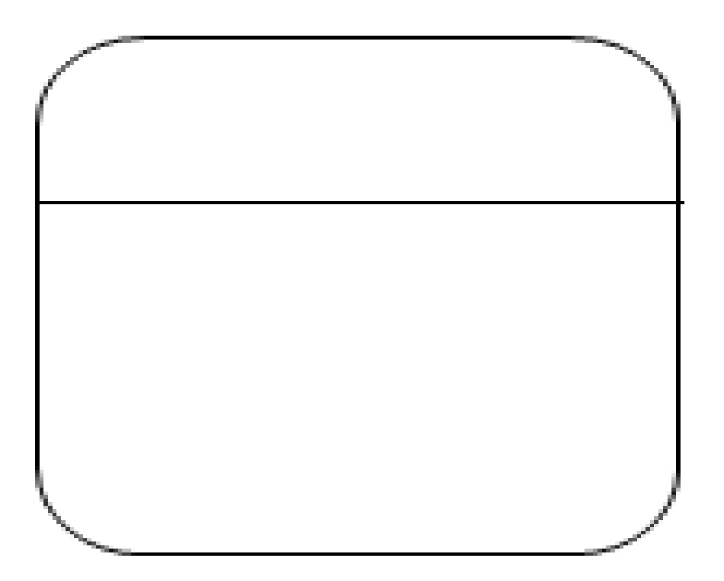
Symbols and Notations Used in DFD
Process
An activity that changes or transforms data flows. Since they transform incoming data to outgoing data, all processes must have inputs and outputs on a DFD.
Process
Process
Yourdon and Coad Notation
Gane and Sarson Notation
Data Flow
Movement of data between external entities, processes and data stores is represented with an arrow symbol, which indicates the direction of flow.

Slide 59
Rules for designing DFD
A process in a Data Flow Diagram (DFD) must have both input and output; it cannot function with only one of them.

Slide 60
Rules for designing DFD
There should not be a direct flow between data stored and external entity. The flow should be go through a process.

Slide 61
Rules for designing DFD
There should not be a direct flow between data stored and external entity. The flow should be go through a process.

Slide 62
W5 Of Data flow diagram
Who uses an DFD?
System analysts, developers, and project stakeholders use DFDs to analyze and document data
flows within a system.
What is an DFD?
A diagram that depicts how data flows through a system, including its inputs, outputs,
processes, and storage points.
Why is an DFD significant?
It provides a clear visualization of data movement, helping to identify system requirements and
improve process understanding.
Where are DFD applied?
They are widely used in system analysis, software development, and business process
modeling.
When do we use an DFD created?
During the planning and design stages of system development to represent data interactions
and flow.

Slide 63
Data flow diagram levels
Data flow diagrams are also categorized by level. Starting with the most basic, level 0, DFDs get increasingly complex as the level increases.
Level 0 DFDs, also known as context diagrams. It provides a basic overview of the whole system.
It shows the system as a single high-level process, with its relationship to external entities.
DFD Level 1 provides a more detailed breakout of pieces of the Context Level Diagram.
You will highlight the main functions carried out by the system, as you break down the high-level process of the Context Diagram into its sub processes.

Slide 64
DFD Level-0 (Context Diagram) For LMS
Assume all process of library.
Request for book
Member
Issue book
Library Management System
Request for generating report
Return book
Search book
Issue and return
book report generated
Result of searching book
Library Staff
Manage member account
Manage book database

Slide 65
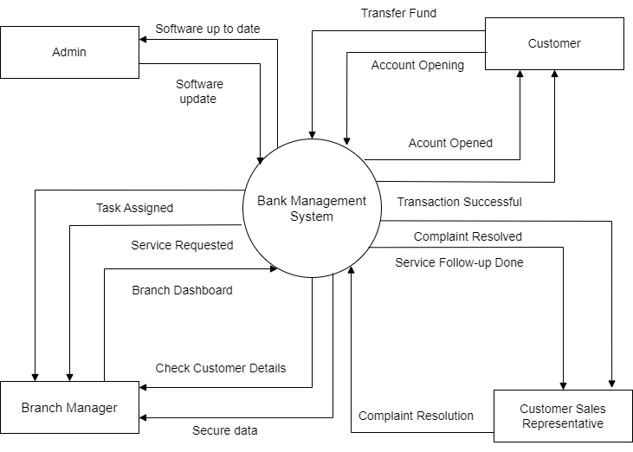
DFD Level-0 (Context Diagram) For BMS
Assume all process of bank.

Slide 66
DFD Level-1 For LMS
Book request
1.0
Issue book
Library card
Book
Book
Book Selves
Member
Book
2.0
Return book
Book
Search query
3.0
Search book
List of titles
Book request by name
title
author
Result by book name
List of author
Search query

Slide 67
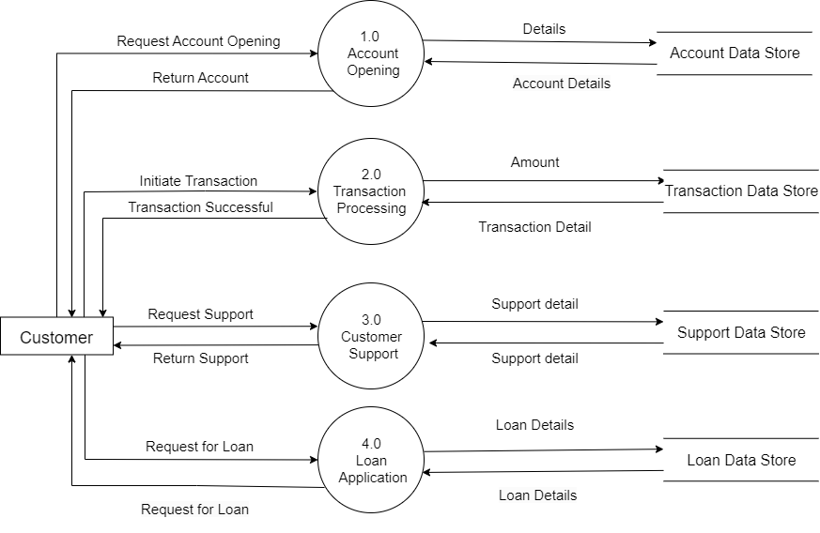
DFD Level-1 For BMS

Slide 68
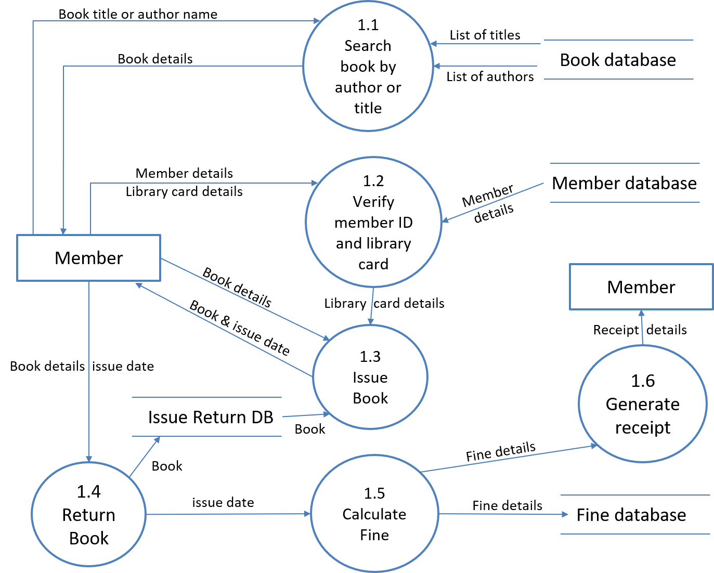
DFD Level-2 For LMS

Slide 69
Software Engineering (2301CS405)
Prof. R. B. Gondaliya
Computer Engineering Department
rajkumar.gondaliya@darshan.ac.in
+91-9723232741

